Slide 1
Safe aging challenge. Predicting healthy longevity from lifestyle and health data
National Research University Higher School of Economics
Data analysis and mining
13 December 2025
by Sovetkina Ludmila
Challenge: https://www.kaggle.com/datasets/zoya77/aging-risk-assessment-dataset

Slide 2
Research objective
National Research University Higher School of Economics
Data analysis and mining
13 December 2025
The goal of the study is to analyse the most probable causes and metrics of aging outcomes. Additionally we have provided a classification model for reliable prediction of outcomes. In this study we are going to:
analyze most reliable metrics to predict undesirable outcome of aging;
analyse most definite causes of undesirable outcomes of aging;
make a classification model to predict undesirable outcomes.

Slide 3
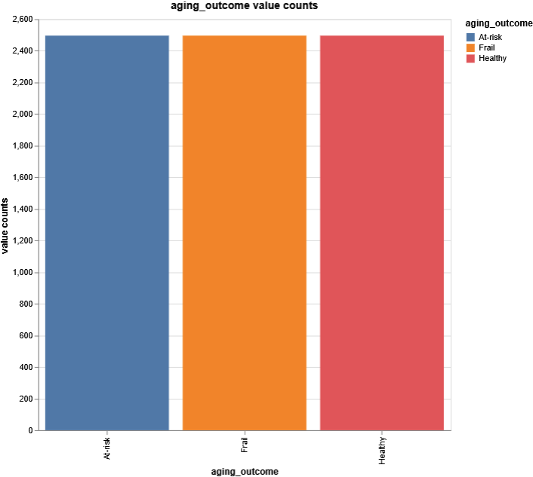
About the dataset
National Research University Higher School of Economics
Data analysis and mining
13 December 2025
This dataset contains 3456 records and is intended for machine learning tasks, particularly classification and regression. It includes synthetic data on aging prediction, where the outcome variable is derived from several features related to an individual's health and lifestyle. The dataset aims to assist in understanding aging patterns and predicting the likelihood of an individual falling into one of the three aging categories: Healthy, At-risk, or Frail. It provides valuable insights into age-related health outcomes based on demographic and lifestyle factors

Slide 4
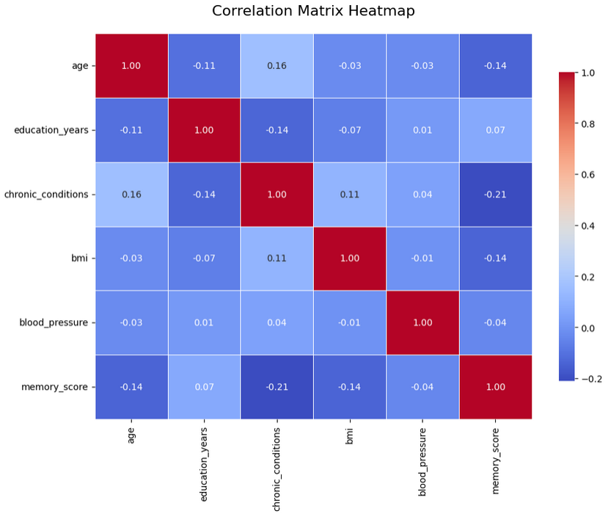
National Research University Higher School of Economics
Data analysis and mining
13 December 2025
Overall the dataset contained 5 numerical, 8 ordinal, and 2 nominal variables with target being an ordinal variable which allows us to explore methods of strict classification and ordinal regressions. We can apply for example Random Forest methods or choice regressions. Because of absence of linear relationships between numeric variables ordinal linear methods would not be considered

Slide 5
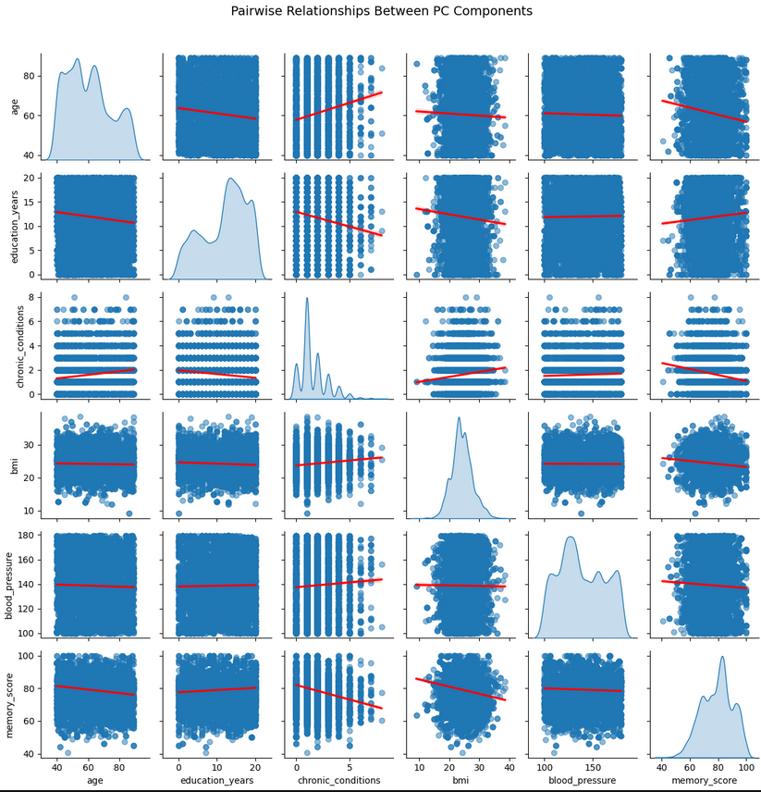
National Research University Higher School of Economics
Data analysis and mining
13 December 2025
The dataset mainly consists of categorical and nominal variables. Additional inspection has showed that dataset is not intendent much for ecomoterics or tasks outside prediction. Most of numeric data is not normally distributed which inflicts certain limitations on interpretations. One exception is BMI.

Slide 6
Predictive modeling
National Research University Higher School of Economics
Data analysis and mining
13 December 2025
In order to examine additional relationships we directly used catboosting models to examine variable importance in predicting the target. That gave us both measure of importance and prediction model. The catboost is used here because of its fluid categorical columns handling and ani-overfit measures built in.
Compared to other approaches it is produces much less overfiting like RandomForests, or XGBoosting or AdaBoosting. Unlike XGBoosting the performance won’t be affected as much by dataset size. To ensure best fit, first we completed grid searching

Slide 7
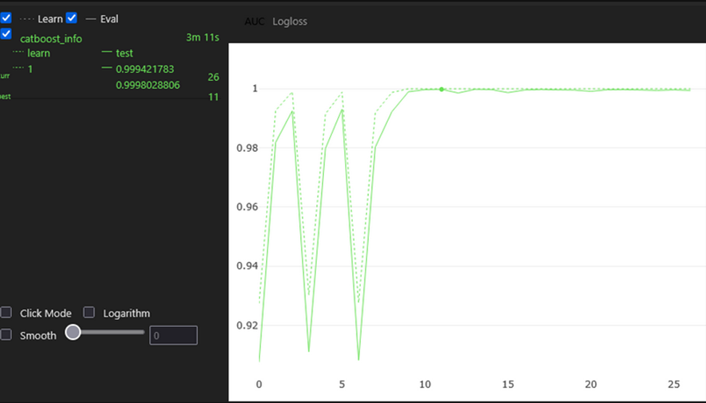
Grid searching results
National Research University Higher School of Economics
Data analysis and mining
13 December 2025
The most appropriate metric in for grid searching usually AUC. This metric is very reliable when assessing multiclass like this one.
The best group of parameters is:
{'depth': 5,
'learning_rate': 0.1,
'l2_leaf_reg': 1}

Slide 8
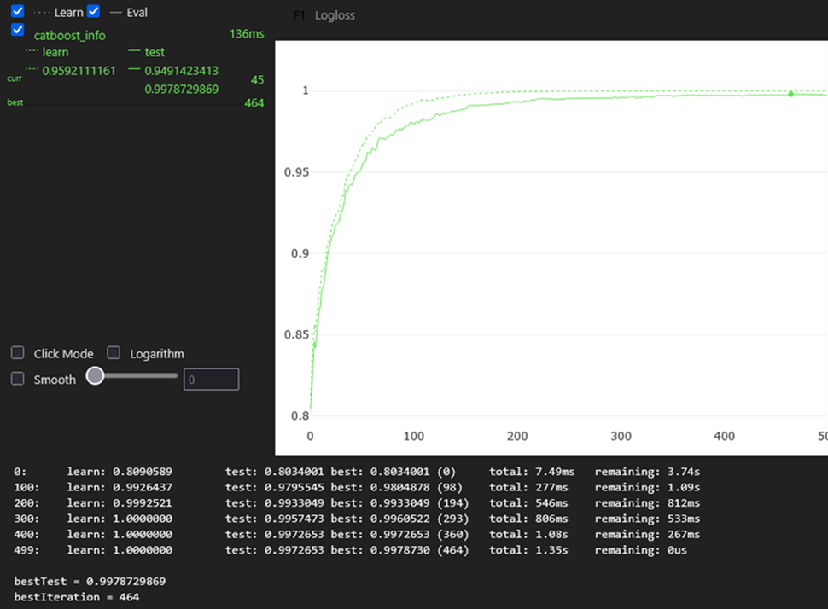
Prediction model design
National Research University Higher School of Economics
Data analysis and mining
13 December 2025
Based on grid search results we trained best model with F1 evaluation metric to ensure absence of false positives (better safe than sorry).
Evidentiality in all trials we ended up with what seems overfitting models. Unfortunately, there’s no room to add artificial variance to combat overfitting. Certainly this is a problem with dataset. Most likely it was downsampled for better classification tasks which damaged data’s explanatory value

Slide 9
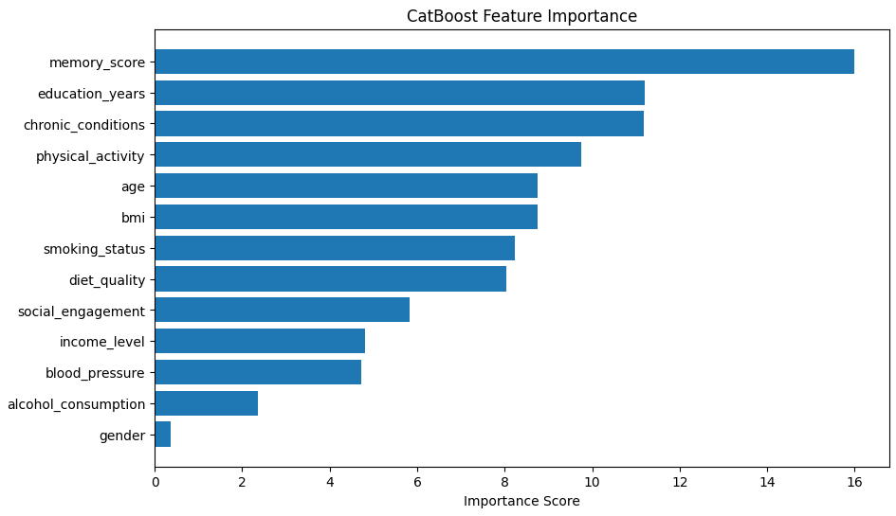
National Research University Higher School of Economics
Data analysis and mining
13 December 2025
Fortunately best fit usually explains all the variance. In case of CatBoost we have gotten feature importance for each predictor. Based on these features we can now analyse importance of variables as metrics or causes of aging outcomes

Slide 10
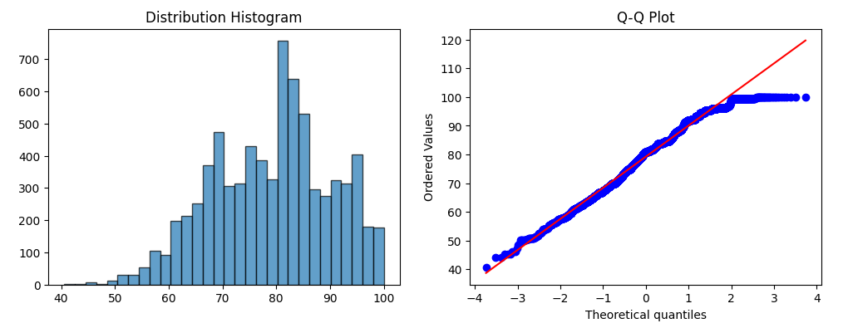
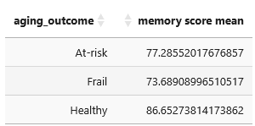
Memory score: the most reliable metric
National Research University Higher School of Economics
Data analysis and mining
13 December 2025
In order to examine differences between groups we opted to ANOVA. As this test is parametric and MS is almost normally distributed

Slide 11
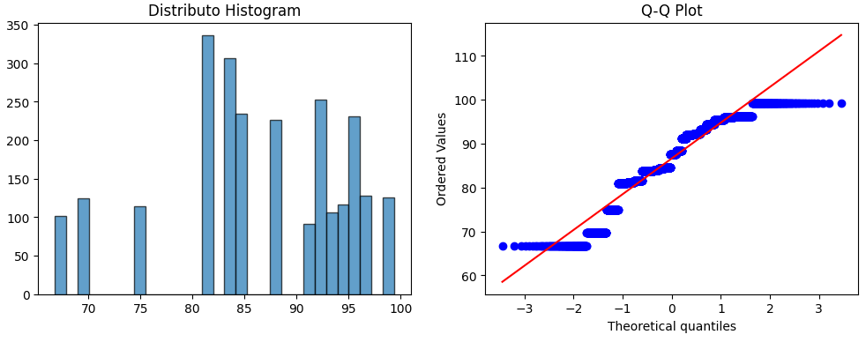
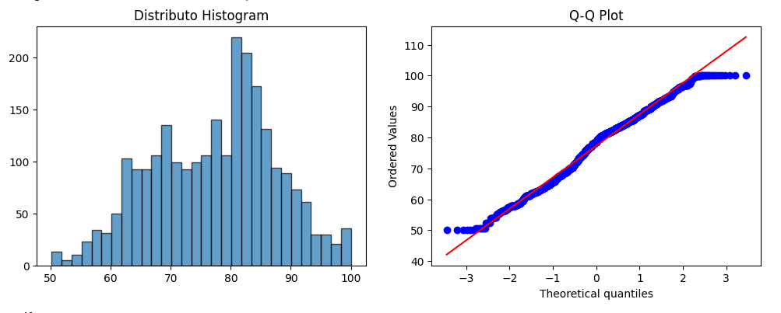
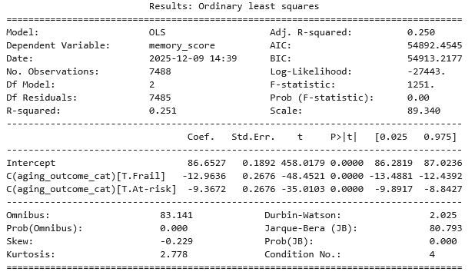
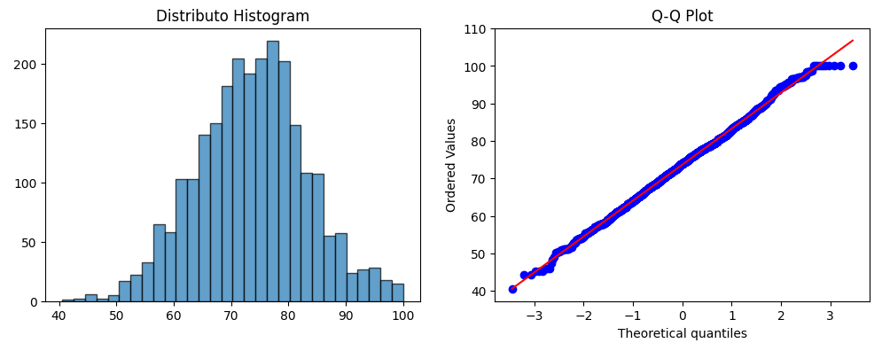
Memory score: not much of a “healthy”
National Research University Higher School of Economics
Data analysis and mining
13 December 2025
Let’s examine distributions of ‘Healthy’, ‘At-Rist’, ‘Frail’. As we can see there’s a severity in distributions. Especially in ‘Healthy’ group. However we continued with ANOVA because there’s other evidence of high differences in MS for groups. Also we assumed that was ‘Healthy’ downsampled with regards to its distribution and its normality

Slide 12
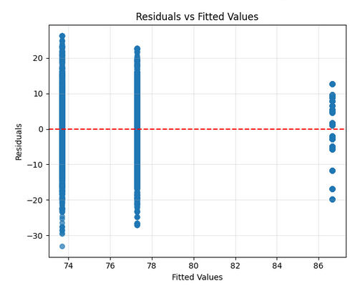
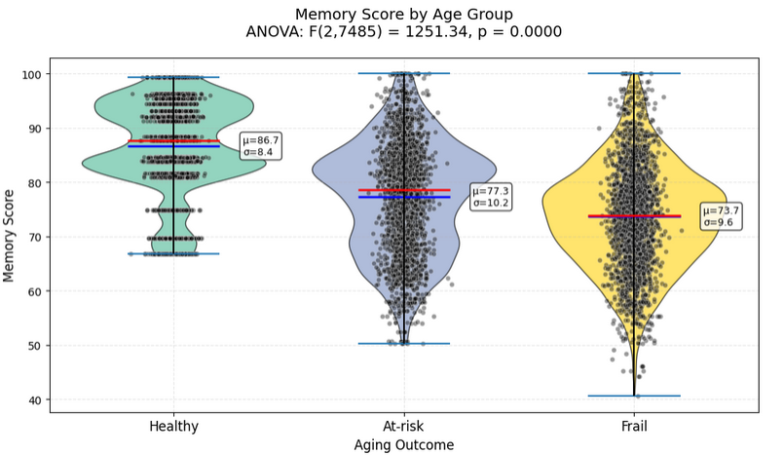
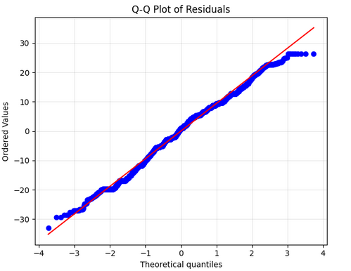
Memory score: differences in distributions
National Research University Higher School of Economics
Data analysis and mining
13 December 2025

Slide 13
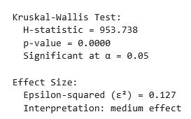
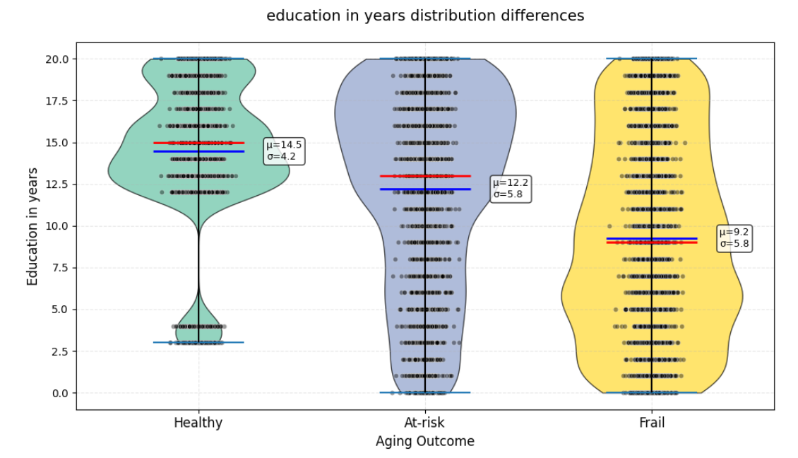
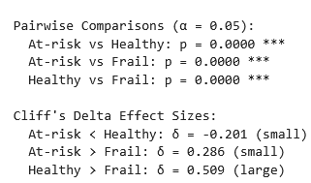
Sources of risk: education in years
National Research University Higher School of Economics
Data analysis and mining
13 December 2025
Parametric test Kruskal-Wallis:

Slide 14
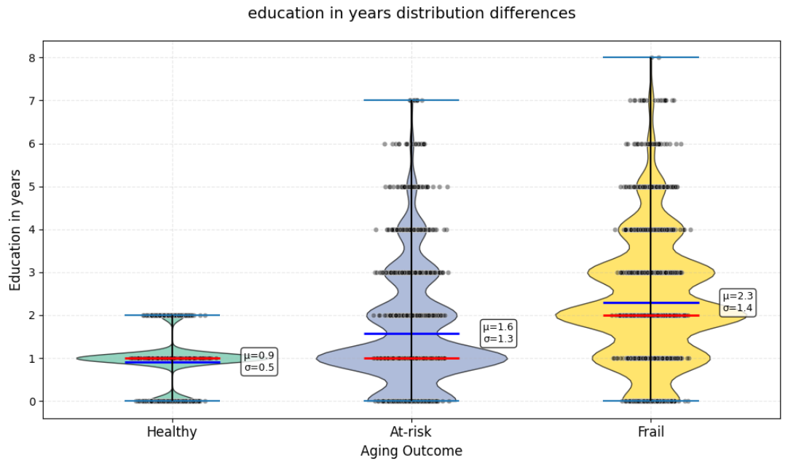
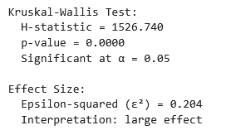
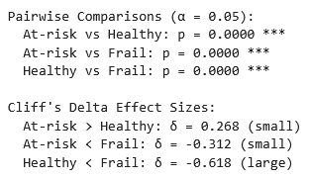
Sources of risk: number of chronic conditions
National Research University Higher School of Economics
Data analysis and mining
13 December 2025
Parametric test Kruskal-Wallis:

Slide 15
Limitations
National Research University Higher School of Economics
Data analysis and mining
13 December 2025
Undersampling the Healthy class: Artificially pruning the records compressed the distributions (short boxes, waves in memory score), causing bias in ANOVA
Model overfitting: CatBoost explains almost all the variance in the training data, but does not transfer well without data augmentation
What to do in the future?
Anti-overfitting: K-fold CV, early stopping in CatBoost, dropout; Add real data (NHANES).
Validation: External test set from real sources; SHAP for causal insights.

Slide 16
National Research University Higher School of Economics
Data analysis and mining
13 December 2025
Conclusion
CatBoostClassifier identified memory_score, education_years, chronic_conditions, and physical_activity as the most important predictive factors for aging outcomes, while gender and income_level were among the least important. It is important to note a significant caveat: the analysis revealed a likely serious undersampling of data from the Healthy group, which has resulted in a damaged distribution for the key memory_score variable. This data loss introduces potential bias into the model and suggests that ANOVA results for the Healthy group should be interpreted with caution.
Despite this limitation, the statistical comparisons revealed strong, graded relationships between aging outcomes and the key factors. Analysis of variance showed that memory_scor significantly declined across groups, with the Healthy group performing best, followed by the At-risk and then Frail groups, with all pairwise differences being statistically significant. Similarly, a clear downward trend in education_years was observed from the Healthy to the Frail group. Conversely, the number of chronic_conditions showed a significant upward trend, with the Frail group reporting the highest burden.

